Slide 1
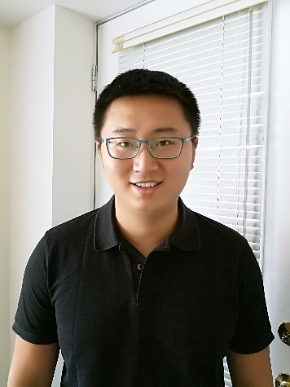
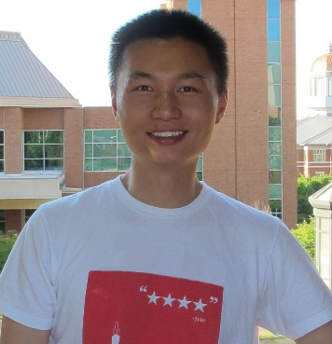
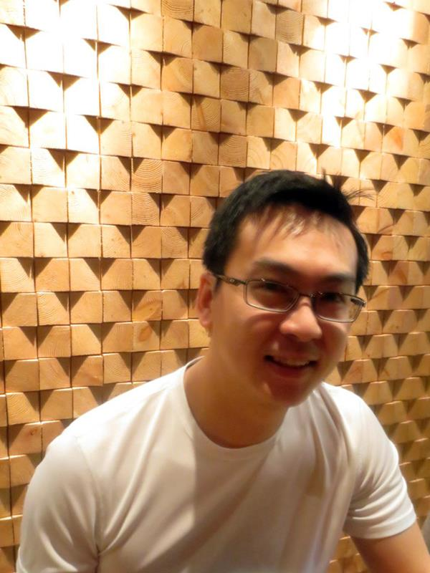
BrailleSketch: A Gesture-based Text Input Method for People with Visual Impairments
ASSETS 2017
Franklin (Mingzhe) Li, Mingming Fan & Khai N. Truong
Notes:
Good Morning! My name is Franklin Li. I am a fourth year undergraduate student from University of Toronto. I am presenting BrailleSketch, a gesture-based text input method for people with visual impairments today. My co-authors are Mingming Fan and Khai Truong.

Slide 2
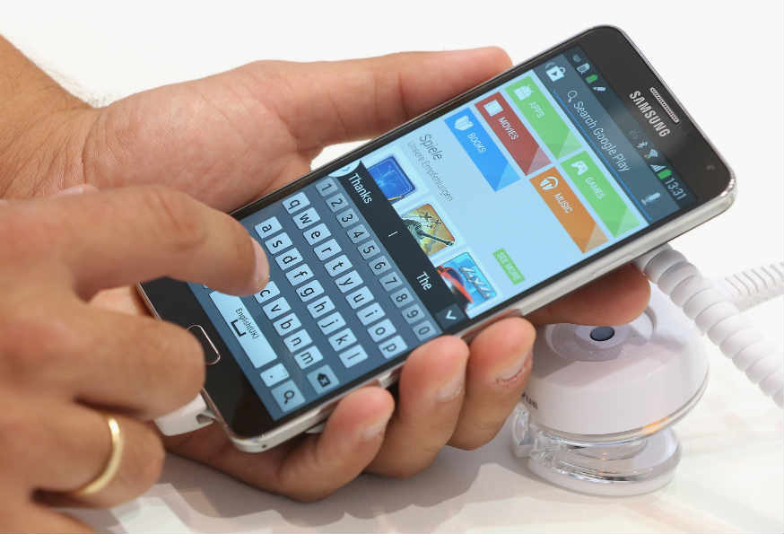
Text entry on touchscreen phones
Common input method: soft onscreen keyboard
Notes:
Most people, nowadays, use touchscreen mobile devices. These devices typically do not have a physical keyboard. Thus, people often use soft onscreen keyboards to input text.

Slide 3
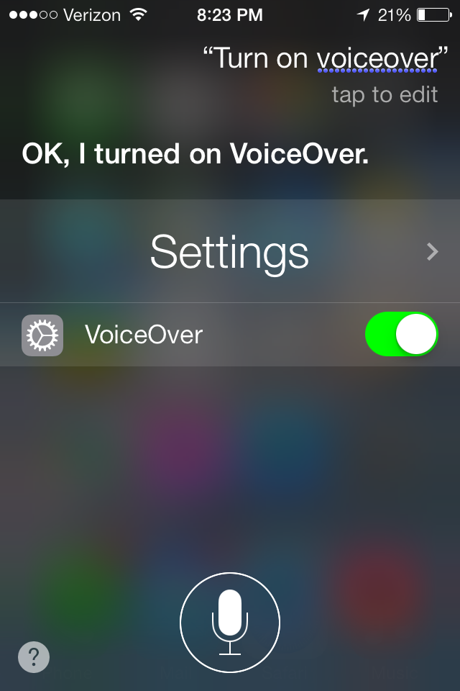
Text entry on touchscreen phones
Common input method: soft onscreen keyboard
Alternate input method:
VoiceOver
Notes:
For visually impaired people, a VoiceOver functionality can be invoked to help users type on the touchscreen. However, prior studies have shown that text input speed using the VoiceOver feature can be very slow.

Slide 4
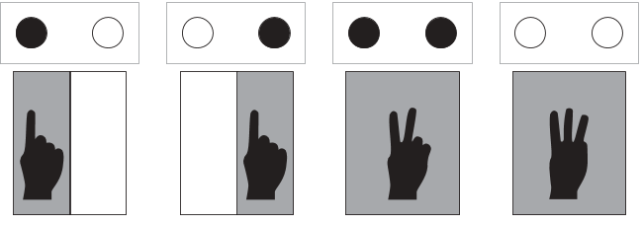
Text entry on touchscreen phones
Common input method: soft onscreen keyboard
Alternate input method:
VoiceOver
Tap & Multi-tap
Notes:
Three additional approaches have also been explored in research literature.
The first enables users to perform tap and multi-taps on the screen to type braille patterns. An example of this is TypeInBraille, which allows the user to use sequential multi-finger taps to type rows of a braille pattern, one at a time. A tap on the left side of the screen specifies that a row only contains a left dot, a tap on the right side specifies that the row only contains a right dot, and a two finger tap indicates that the row contains both dots while a three finger tap indicates a blank row. Tap and multi-tap interfaces have been heavily explored, but this approach is typically a fairly slow way for users to type.

Slide 5
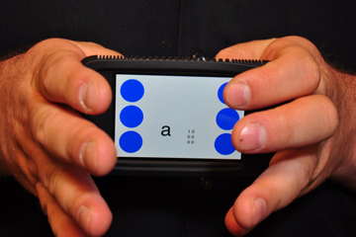
Text entry on touchscreen phones
Common input method: soft onscreen keyboard
Alternate input method:
VoiceOver
Tap & Multi-tap
Chorded typing
Notes:
The second approach allows users perform chorded typing to input text. For example, BrailleTouch interprets simultaneous finger presses from both hands as braille patterns. This approach can support faster input, but can be more difficult than tapping and multi-tapping interfaces, and may produce more errors.

Slide 6
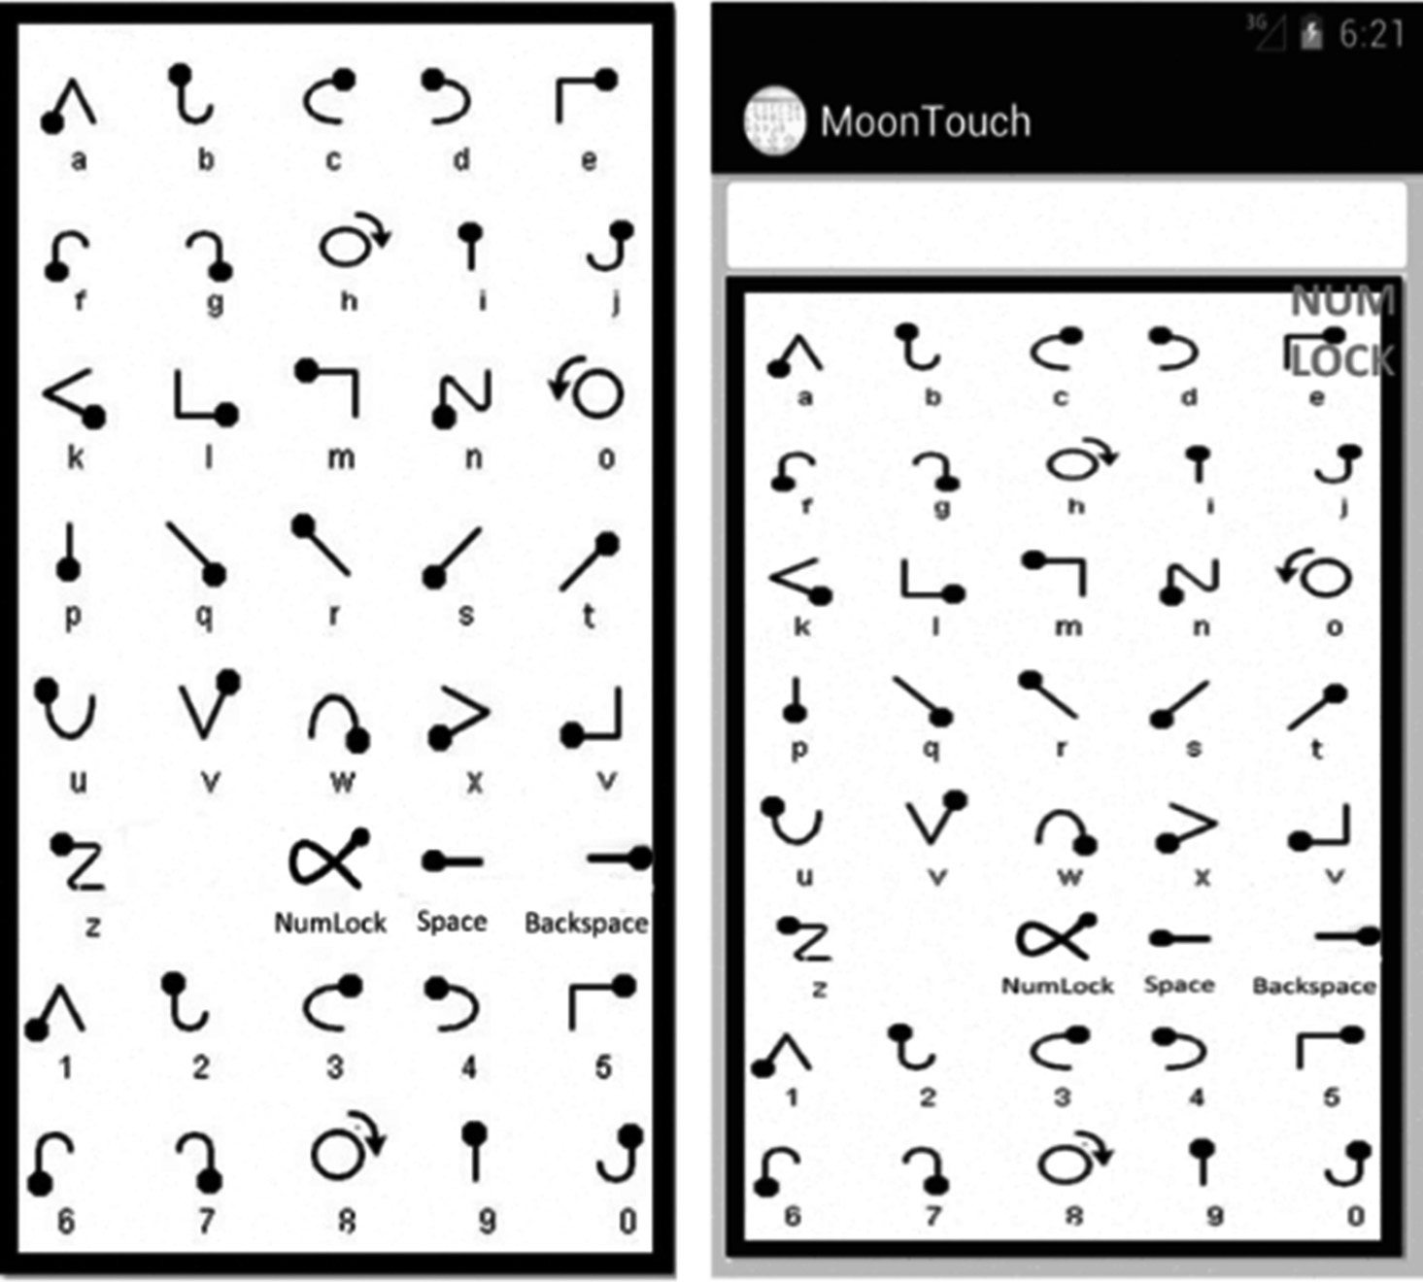
Text entry on touchscreen phones
Common input method: soft onscreen keyboard
Alternate input method:
VoiceOver
Tap & Multi-tap
Chorded typing
Gesture
Notes:
The final approach support input through gestures drawn on the screen. For example, the MoonTouch system allows users to input text by drawing unistroke gestures that were created based on the Moon alphabet to type letters. This approach has been less commonly explored as an input method for user with visual impairments, and may require users to learn a gesture vocabulary that is not already familiar to them.

Slide 7
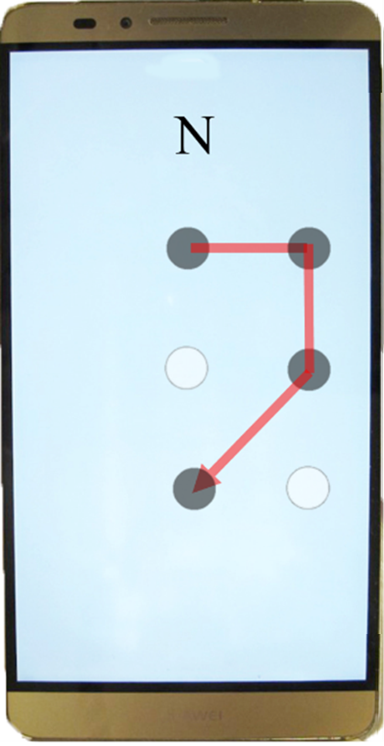
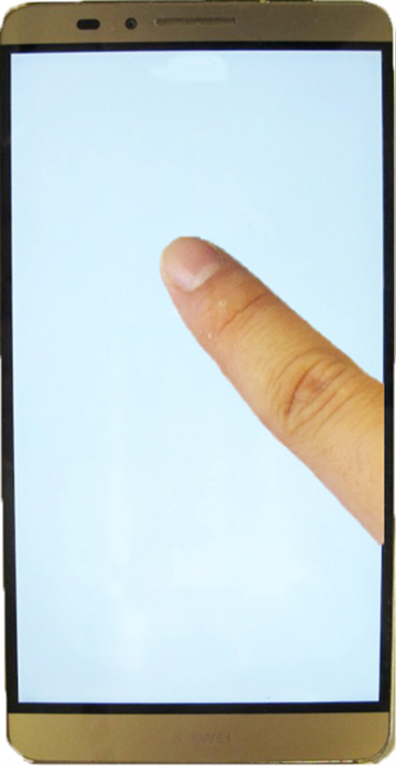
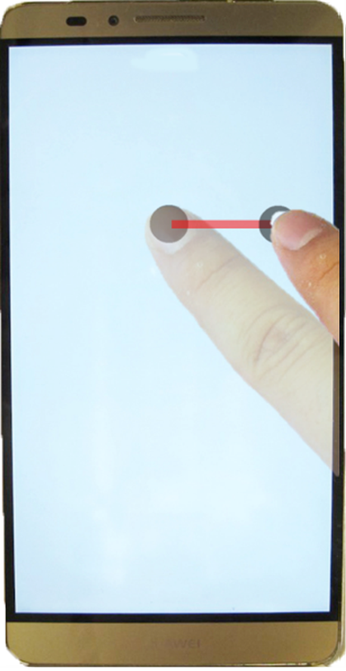
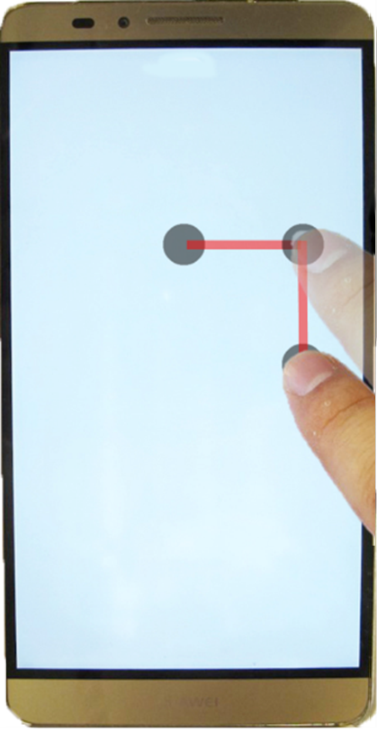
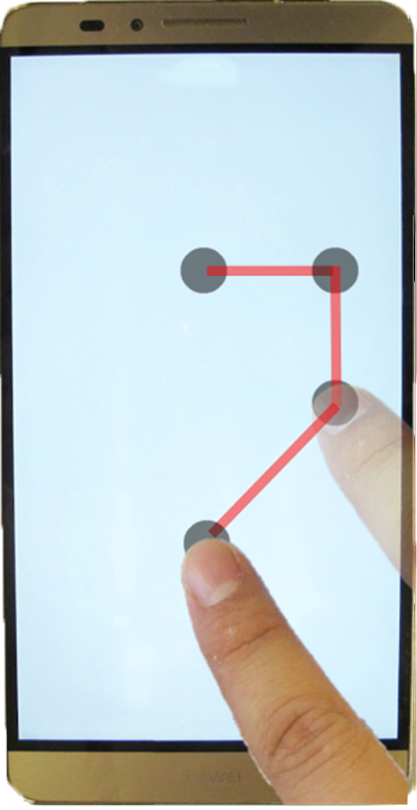
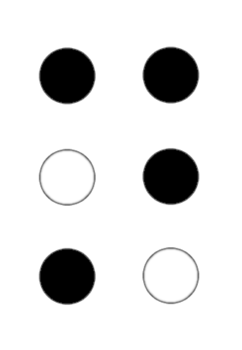
BrailleSketch
Supports Braille alphabet based gesture input
Notes:
In this project, we focus on expanding the third approach of the input method. We explore this approach by performing gestures without requiring them to learn a new gesture vocabulary. We developed a method, called BrailleSketch, which leverages the user’s potential knowledge of the braille alphabet. To use BrailleSketch, the user simply places her finger anywhere on the touch screen and sketches a path that passes through all the dots in a Braille code in a way that is intuitive to her.

Slide 8
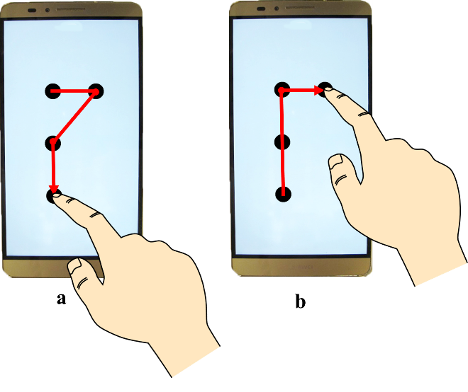
BrailleSketch
Supports Braille alphabet based gesture input
Enables Braille patterns to be sketched however users want
Notes:
In terms of Braille gesture input, users could sketch braille patterns as their want in BrailleSketch. For example, this figure shows two different ways of sketching letter “P”. Users can sketch letter “P” by moving horizontally right, diagonally left down, and vertically down. Users can also sketch it by moving vertically up, vertically up, and horizontally right.

Slide 9
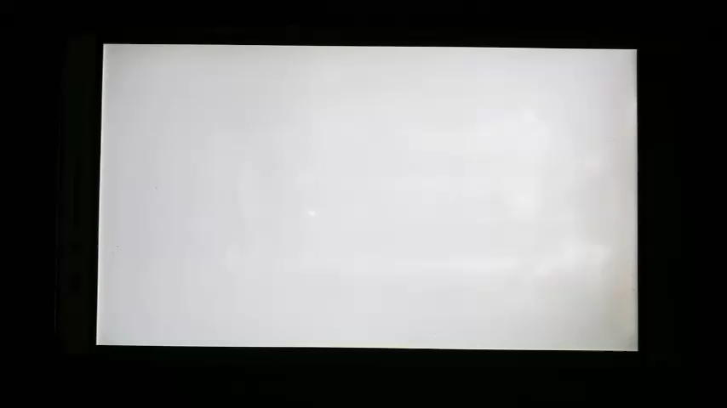
BrailleSketch
Supports Braille alphabet based gesture input
Enables Braille patterns to be sketched however users want
Allows input gesture to be performed from anywhere on the screen
Notes:
The second key feature is that the input method allows the user to perform gestures by touching anywhere on the screen. When the user touches the screen, the system creates a grid of dots underneath the user's finger. When the user draws a braille pattern, the dots crossed over by the gesture path are selected. The user lifts her finger when she is done drawing. The system then uses the set of dots selected to determine the letter that the user wanted to type. This is the video shows what that grid of dots looks like and two ways of sketching letter P. These two ways of sketching are same as the previous figure.

Slide 10
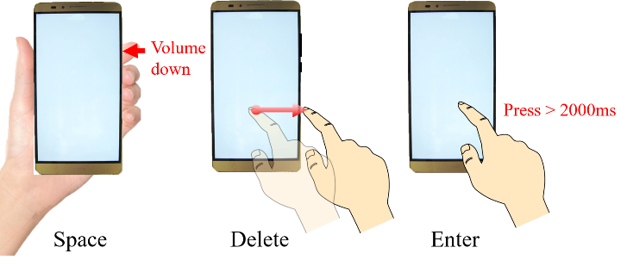
Other aspects of BrailleSketch system
Space, delete & enter
Notes:
The user can type “Space” by pressing the volume down button. The user can “Delete” by swiping right and off the screen, and “Enter” by performing a long touch at the same screen location for more than 2000ms.

Slide 11

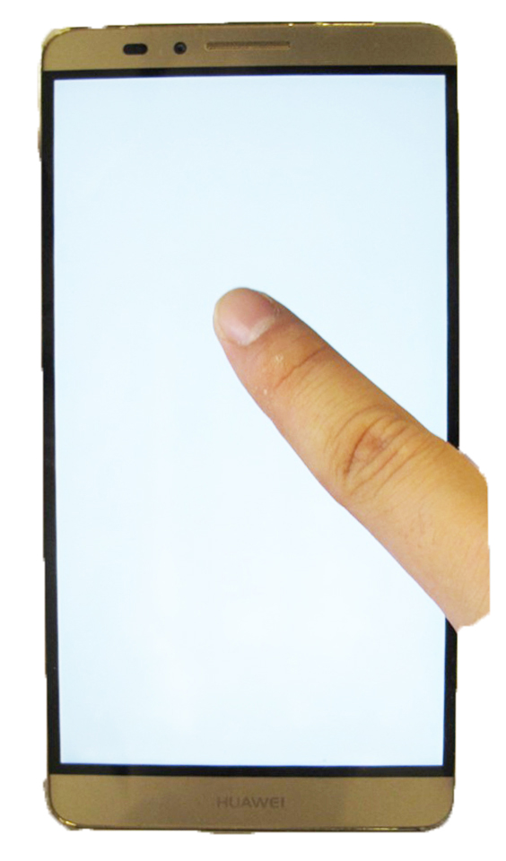
Other aspects of BrailleSketch system
Space, delete & enter
Audio feedback:
Gesture-level
Word-level
200Hz
1000Hz
Notes:
To provide users feedback information while they are using BrailleSketch, we implemented audio feedbacks. BrailleSketch provides user audio feedback of directions while typing. The audio feedback is 200Hz if user is moving diagonally and this is the tone of 200Hz. The audio feedback is 1000Hz for moving cardinally and this is the tone of 1000Hz. Users would also be provided word level audio feedback by speaking out the “WORD” they typed after they finished typing a “SPACE”.

Slide 12
Other aspects of BrailleSketch system
Space, delete & enter
Audio feedback:
Gesture-level
Word-level
Auto correction
Notes:
Auto Correction is also implemented in BrailleSketch to fix mistyping errors.

Slide 13


User study
10 participants
Average age: 50.3
Average years of experience with Braille: 32.3
All participants are legally blind (20/200) & four were blind since born
Notes:
We conducted user study in CNIB(Canadian National Institute for the Blind) in Toronto. We recruited 10 participants with average ages of 50.3. Participants have experienced with Braille for 32.3 years in average. All of the participants are legally blind, which is 20/200. Four of them were blind since born.

Slide 14
User study design
Each participant performed 5 typing sessions
Each session consisted of:
15-minute free typing
3-phrase fast typing
Notes:
According to other approaches like BrailleTouch and TypeInBraille, they conducted the study for 5 sessions and 20 minutes each session. For MoonTouch, one of the gesture input method, used the protocol of having a training session which takes 15-20 mins and an evaluation session which asked user to type 3 phrases. To follow similar protocol of user study, each session of BrailleSketch consists of a 15-minute free typing session and a 3-phrase fast typing session. Participants need to finish 5 sessions. Each session required user to type about 20 mins in total.

Slide 15
Results: average text input speed
15-minute free typing session
5.37 wpm to 11.39 wpm
3-phrase fast typing session
6.56 wpm to 14.53 wpm
Notes:
In terms of the result, we can see that the average speed of 15-minute free typing tests increased from 5.37 wpm of the first session to 11.39 wpm of the last session. The 3-phrase fast typing tests increased from 6.56 wpm to 14.53 wpm.

Slide 16
Results: average total error rate
15-minute free typing session
0.439 to 0.148
3-phrase fast typing session
0.308 to 0.106
Notes:
In terms of the average total error rate, it decreased from 0.439 to 0.148 for 15-minute free typing tests and 0.308 to 0.106 for 3-phrase fast typing tests.

Slide 17
Results
Text entry approach | Input speed (WPM) | Total error rate
TypeInBraille (Tap & multi-tap) | 6.3 | 0.03
BrailleTouch (Chorded typing) | 20.09 | 0.24
MoonTouch (Gesture) | 10.14 | N/A
BrailleSketch (Gesture) | 14.53 | 0.11
Notes:
Here are results of three different approaches including BrailleSketch. We can see that TypeInBraille, which performed by taping and multi-taping, has an average speed of 6.3 WPM and an average total error rate of 0.03. BrailleTouch, which performed by chording typing, has an average speed of 20.09 WPM and an average error rate of 0.24. Moontouch, which implement gesture input, has an average speed of 10.14 WPM. BrailleSketch, which is Braille gesture based method, has 14.53 WPM of average speed and 0.11 of the average error rate.

Slide 18
Discussion: error rate
Average total error rate after the last session: 0.11
Corrected error rate: 0.079
Uncorrected error rate: 0.03
High error rate
An error occurred for ~1 out of every 10 input
Notes:
Although our user study uncovered promising results for BrailleSketch, the total error rate after the last session is still very high. An error occurred about once out of every 10 input. As a result, participants needed to correct their input about 8% of the time.

Slide 19
Discussion: error rate
Average total error rate after the last session: 0.11
Corrected error rate: 0.079
Uncorrected error rate: 0.03
Primary causes of high error rate:
Ineffective audio feedback
Notes:
One of the reasons why the error rate was high was because the system provided audio feedback that was not helpful to the user. For example, in the current implementation: after the user draws the gesture path over a dot, the system then recognizes the position of the user’s finger relative to the previous selected dot. The system only then provides audio feedback that indicates if the current dot that has been selected is in a diagonal direction or a cardinal direction from the previous dot. This type of feedback does not allow the user to correct their input as they are drawing the gesture. Their only option is to delete the gesture after they lift their finger from the screen and retype the letter. Better audio feedback design needs to be implemented to lower the high error rate.

Slide 20
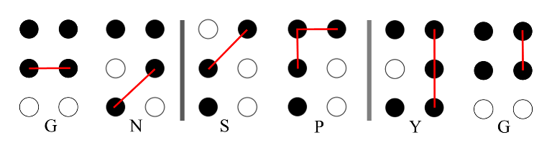
Discussion: error rate
Average total error rate after the last session: 0.11
Corrected error rate: 0.079
Uncorrected error rate: 0.03
Primary causes of high error rate:
Ineffective audio feedback
System often confused some letters
The length of the gesture did not match what was intended
An intended dot was missed
A selected dot was not in the correct direction from the previous dot
Notes:
The second reason why the error rate was high was because the system would confuse what the user intended to type with another letter. For example, the system would often confuse the gesture for the Braille pattern of the letter “g” for “n”, “s” for “p” and “y” for “g”.
[click animation]
These examples demonstrate that sometimes a selected dot was not in the correct direction from the previous dot…or an intended dot was missed…and the length of the gesture did not match what was intended.
This might be caused because of the ineffective audio feedback currently provided to the users. At the same time, the system could also be designed to help the user correct errors better given it’s knowledge of the commonly confused letters and these causes.

Slide 21
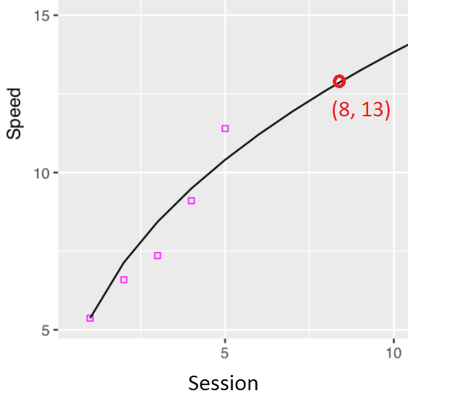
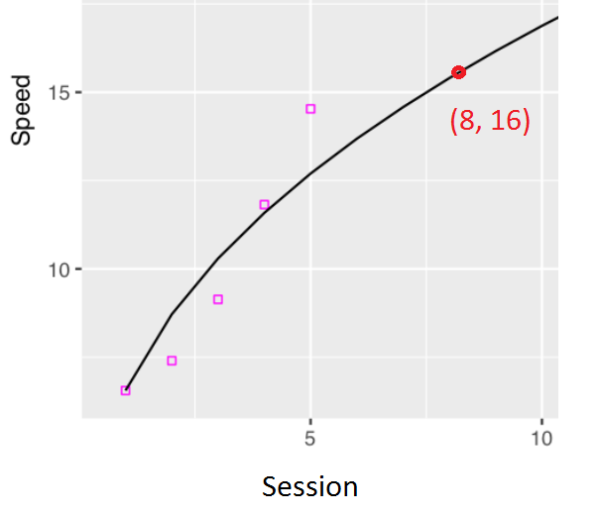
Discussion: input speed
Simple linear regression model of potential input speed after a few additional sessions
15-minute free typing
3-phrase fast typing
Speed (wpm)
Speed (wpm)
R^2 = 0.96670659503614
R^2 = 0.946113121705542
~16 WPM after 8 sessions
~13 WPM after 8 sessions
Session
Notes:
Despite the high error rate, participants were already able to achieve 14.57 WPM after only 5 sessions or about 100 minutes of typing. We created a simple linear regression model to project what the potential input speed could reach after a few additional sessions. The results show that after 8 sessions—or roughly 3 hours of typing), participants may be able to achieve 16 WPMs. We’re optimistic that with some of the proposed ways of lowering the error rate, and additional typing practice, participants will be able to reach this speed and potentially continue to improve.

Slide 22
Conclusion
BrailleSketch—a gesture-based input method which leverages the user’s knowledge of the Braille alphabet
Participants were able to input text at 6.56 WPM after only 1 typing session, and reached 14.53 WPM with an error rate of 0.11 after only 5 sessions
Potential improvements:
Support better audio feedback
Handle commonly confused gestures
THANK YOU!
For more information, contact: franklin.li@mail.utoronto.ca
Notes:
In conclusion, I have presented the design and evaluation of BrailleSketch.
BrailleSketch is a gesture-based input method, which leverages the user’s knowledge of the Braille alphabet
Because participants had a familiarity with the Braille alphabet, they were able to quickly learn to use the system and could input text at 6.56 WPM after only 1 typing session
Subsequently, they were able to reach 14.53 WPM with an error rate of 0.11 after only 5 sessions.
We are optimistic that users will continue to be able to improve with the system, however, as we discussed, the system needs to be improved as well.
Specifically, we discussed the need for better audio feedback and the need to handle commonly confused gestures.
Thank you for your attention.

